Slide 1
Canter Creek Park Project Update
September 30, 2020, 7 pm
Virtual Community Meeting

Slide 2
Agenda
Project Background
Park Planning Process
Subregion VI Master Plan
Community Engagement
Project Description
Proposed Amenities
Site Orientation
Design Update
Proposed Park
Next Steps
Q&A

Slide 3
Background
Park Planning Process
Subregion VI Master Plan
Mandatory Dedication
Level of Service
Community Meetings
Park Feedback
Community At-Large
Canter Creek Neighborhood

Slide 4
Service Area

Slide 5
Service Area
50 acre “floating”
park needs symbol

Slide 6
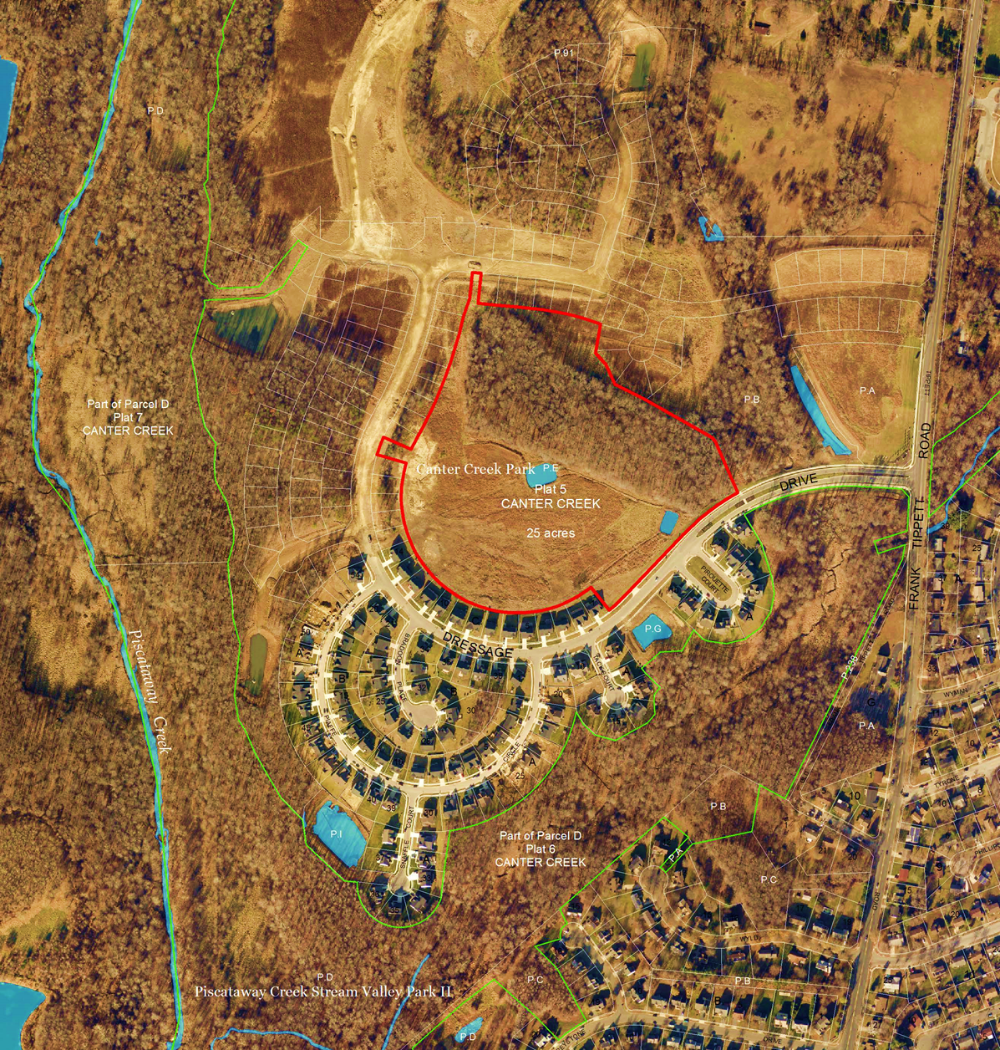
Project Description
Design and construction of a new community park per Subregion VI Master Plan
Proposed Amenities:
Terrace
Playground
Parking Lot
Open Space
Play Courts
Loop Trail
Site Orientation:
25-acre parcel of land
Woodland Preservation Area
Piscataway Creek Stream Valley Park

Slide 7
Proposed Park

Slide 8
Canter Creek Playground

Slide 9
Canter Creek Trail

Slide 10
Canter Creek Youth Courts

Slide 11
Next Steps
Mandatory Referral – Fall 2020
Construction Documents Completion – Early Spring 2021
Construction Start – Summer 2021
Construction Completion – Summer 2022

Slide 12
Q&A

Slide 13
THANK YOU

